Slide 1
Model Pressure vessel
CS229 Project – Calvin McSweeny

Slide 2
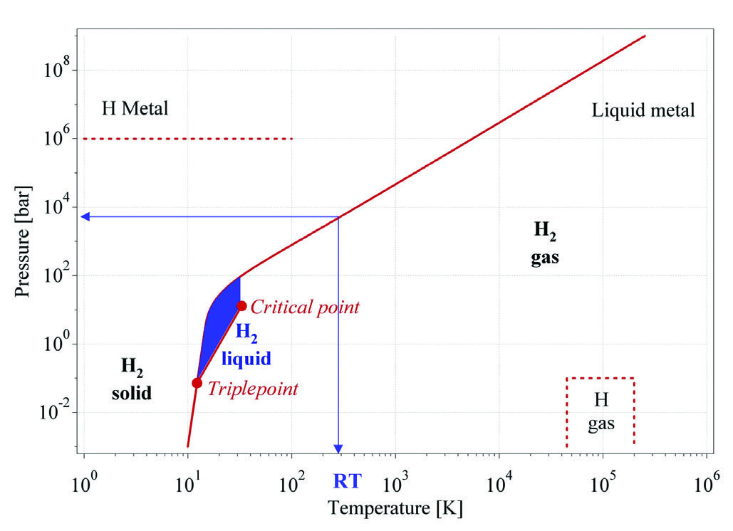
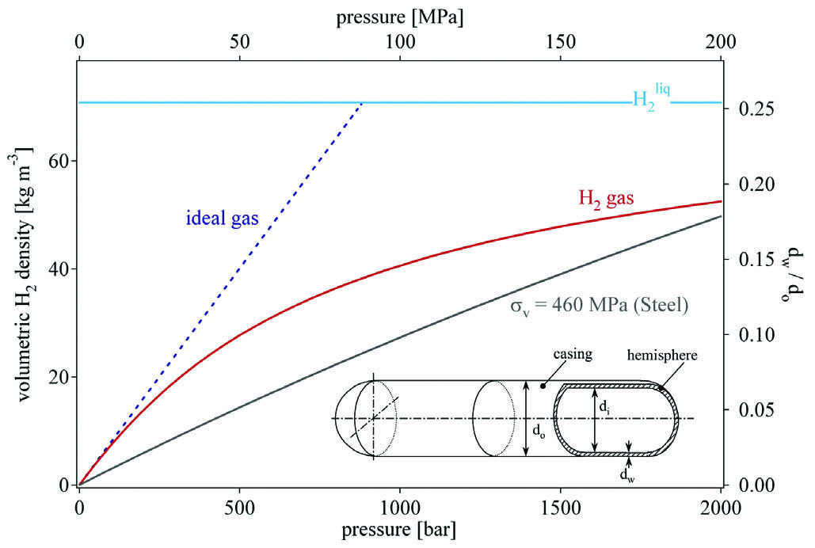
Presentation

Slide 3
Parameters , inputs and inputs of the model
Parameters
Mechanical characteristics of vessel
Characteristics compressor
Compression factor
Inputs
Initial gas vessel pressure
Gas vessel temperature
Outputs
Final gas vessel pressure
Mechanical work required

Slide 4
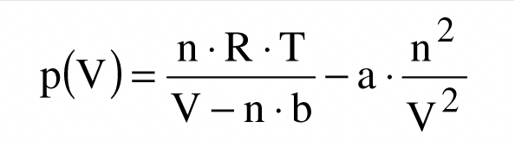
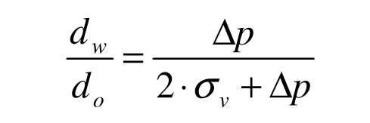
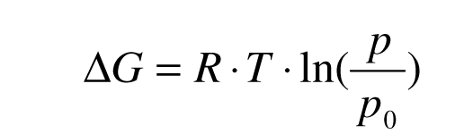
Modelling
State equation of H2 (Van der Waals):
Characteristics of the pressure vessel:
Work required for compression:
Assumption of an isothermal compression ( error of <6% for 0.1MPa<P<100MPa)
Modelling of the throttling not required

Slide 5
References
Hydrogen storage methods – A. Zuettel (Switzerland), 2003
https://ac.els-cdn.com/S1369702103009222/1-s2.0-S1369702103009222-main.pdf?_tid=1dada315-3a00-4be3-adb2-4022e212b8d0&acdnat=1539403964_c0a2f065129c1217b3141c3debb8e872
More advanced modelling and experimental data – (Brazil), 2014
http://www.scielo.br/pdf/bjce/v33n2/0104-6632-bjce-33-02-0391.pdf
Handbook of hydrogen storage – M. Hirscher, 2009 [p.8-15 -> model in gaseous case]
http://www.ese.iitb.ac.in/~pratibha/images/Hirscher%20M.%20(ed.)%20Handbook%20of%20Hydrogen%20Storage%20(Wiley,%202009.pdf

